Slide 1
Operating System
Lecture 7: Inter Process Communication
Manoj Kumar Jain
M.L. Sukhadia University Udaipur

Slide 2
Outline
Inter Process Communication
Communication in Client-Server Systems
Manoj Kumar Jain Professor Computer Science MLSU Udaipur

Slide 3
Inter Process Communication (IPC)
Mechanism for processes to communicate and to synchronize their actions.
Message system – processes communicate with each other without resorting to shared variables.
IPC facility provides two operations:
  send(message) – message size fixed or variable
  receive(message)
Manoj Kumar Jain Professor Computer Science MLSU Udaipur

Slide 4
IPC (Cont.)
If P and Q wish to communicate, they need to:
  establish a communication link between them
  exchange messages via send/receive
Implementation of communication link
  physical (e.g., shared memory, hardware bus)
  logical (e.g., logical properties)
Manoj Kumar Jain Professor Computer Science MLSU Udaipur

Slide 5
Implementation Questions
How are links established?
Can a link be associated with more than two processes?
How many links can there be between every pair of communicating processes?
What is the capacity of a link?
Is the size of a message that the link can accommodate fixed or variable?
Is a link unidirectional or bi-directional?
Manoj Kumar Jain Professor Computer Science MLSU Udaipur

Slide 6
Direct Communication
Processes must name each other explicitly:
  send (P, message) – send a message to process P
  receive(Q, message) – receive a message from process Q
Properties of communication link
  Links are established automatically.
  A link is associated with exactly one pair of communicating processes.
  Between each pair there exists exactly one link.
  The link may be unidirectional, but is usually bi-directional.
Manoj Kumar Jain Professor Computer Science MLSU Udaipur

Slide 7
Indirect Communication
Messages are directed and received from mailboxes (also referred to as ports).
  Each mailbox has a unique id.
  Processes can communicate only if they share a mailbox.
Properties of communication link
  Link established only if processes share a common mailbox
  A link may be associated with many processes.
  Each pair of processes may share several communication links.
  Link may be unidirectional or bi-directional.
Manoj Kumar Jain Professor Computer Science MLSU Udaipur

Slide 8
Indirect Communication
Operations
  create a new mailbox
  send and receive messages through mailbox
  destroy a mailbox
Primitives are defined as:
send(A, message) – send a message to mailbox A
receive(A, message) – receive a message from mailbox A
Manoj Kumar Jain Professor Computer Science MLSU Udaipur

Slide 9
Indirect Communication
Mailbox sharing
  P₁, P₂, and P₃ share mailbox A.
  P₁, sends; P₂ and P₃ receive.
  Who gets the message?
Solutions
  Allow a link to be associated with at most two processes.
  Allow only one process at a time to execute a receive operation.
  Allow the system to select arbitrarily the receiver. Sender is notified who the receiver was.
Manoj Kumar Jain Professor Computer Science MLSU Udaipur

Slide 10
Synchronization
Message passing may be either blocking or non-blocking.
Blocking is considered synchronous
Non-blocking is considered asynchronous
send and receive primitives may be either blocking or non-blocking.
Manoj Kumar Jain Professor Computer Science MLSU Udaipur

Slide 11
Buffering
Queue of messages attached to the link; implemented in one of three ways.
  1. Zero capacity – 0 messages
  Sender must wait for receiver.
  2. Bounded capacity – finite length of n messages
  Sender must wait if link full.
  3. Unbounded capacity – infinite length
  Sender never waits.
Manoj Kumar Jain Professor Computer Science MLSU Udaipur

Slide 12
Client-Server Communication
Sockets
Remote Procedure Calls
Remote Method Invocation (Java)
Manoj Kumar Jain Professor Computer Science MLSU Udaipur

Slide 13
Sockets
A socket is defined as an endpoint for communication.
Concatenation of IP address and port
The socket 161.25.19.8:1625 refers to port 1625 on host 161.25.19.8
Communication consists between a pair of sockets.
Manoj Kumar Jain Professor Computer Science MLSU Udaipur

Slide 14

Socket Communication
Manoj Kumar Jain Professor Computer Science MLSU Udaipur

Slide 15
Remote Procedure Calls
Remote procedure call (RPC) abstracts procedure calls between processes on networked systems.
Stubs – client-side proxy for the actual procedure on the server.
The client-side stub locates the server and marshalls the parameters.
The server-side stub receives this message, unpacks the marshalled parameters, and peforms the procedure on the server.
Manoj Kumar Jain Professor Computer Science MLSU Udaipur

Slide 16

Execution of RPC
Manoj Kumar Jain Professor Computer Science MLSU Udaipur

Slide 17
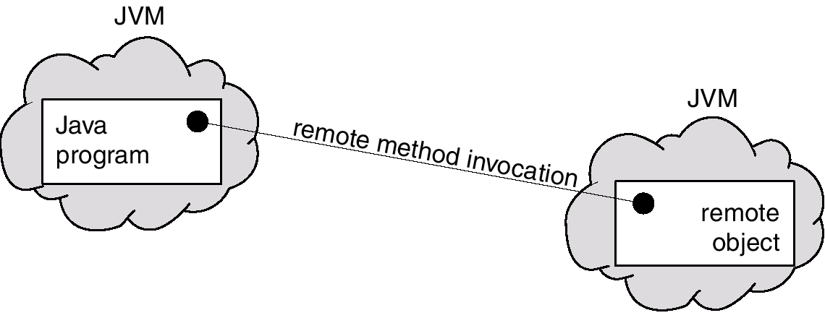
Remote Method Invocation
Remote Method Invocation (RMI) is a Java mechanism similar to RPCs.
RMI allows a Java program on one machine to invoke a method on a remote object.
Manoj Kumar Jain Professor Computer Science MLSU Udaipur

Slide 18
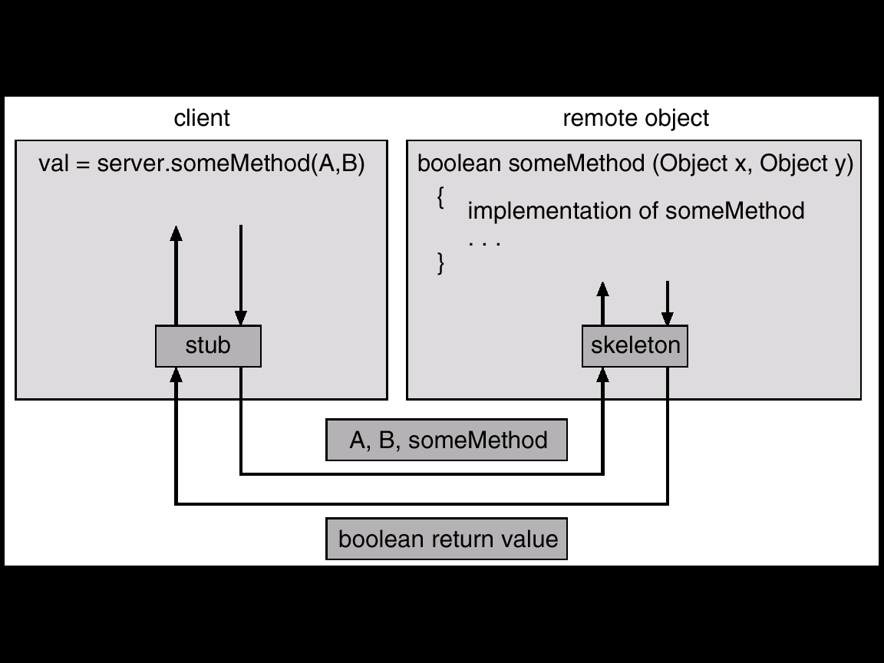
Marshalling Parameters
Manoj Kumar Jain Professor Computer Science MLSU Udaipur

Slide 19
Thanks
Manoj Kumar Jain Professor Computer Science MLSU Udaipur

